Slide 1
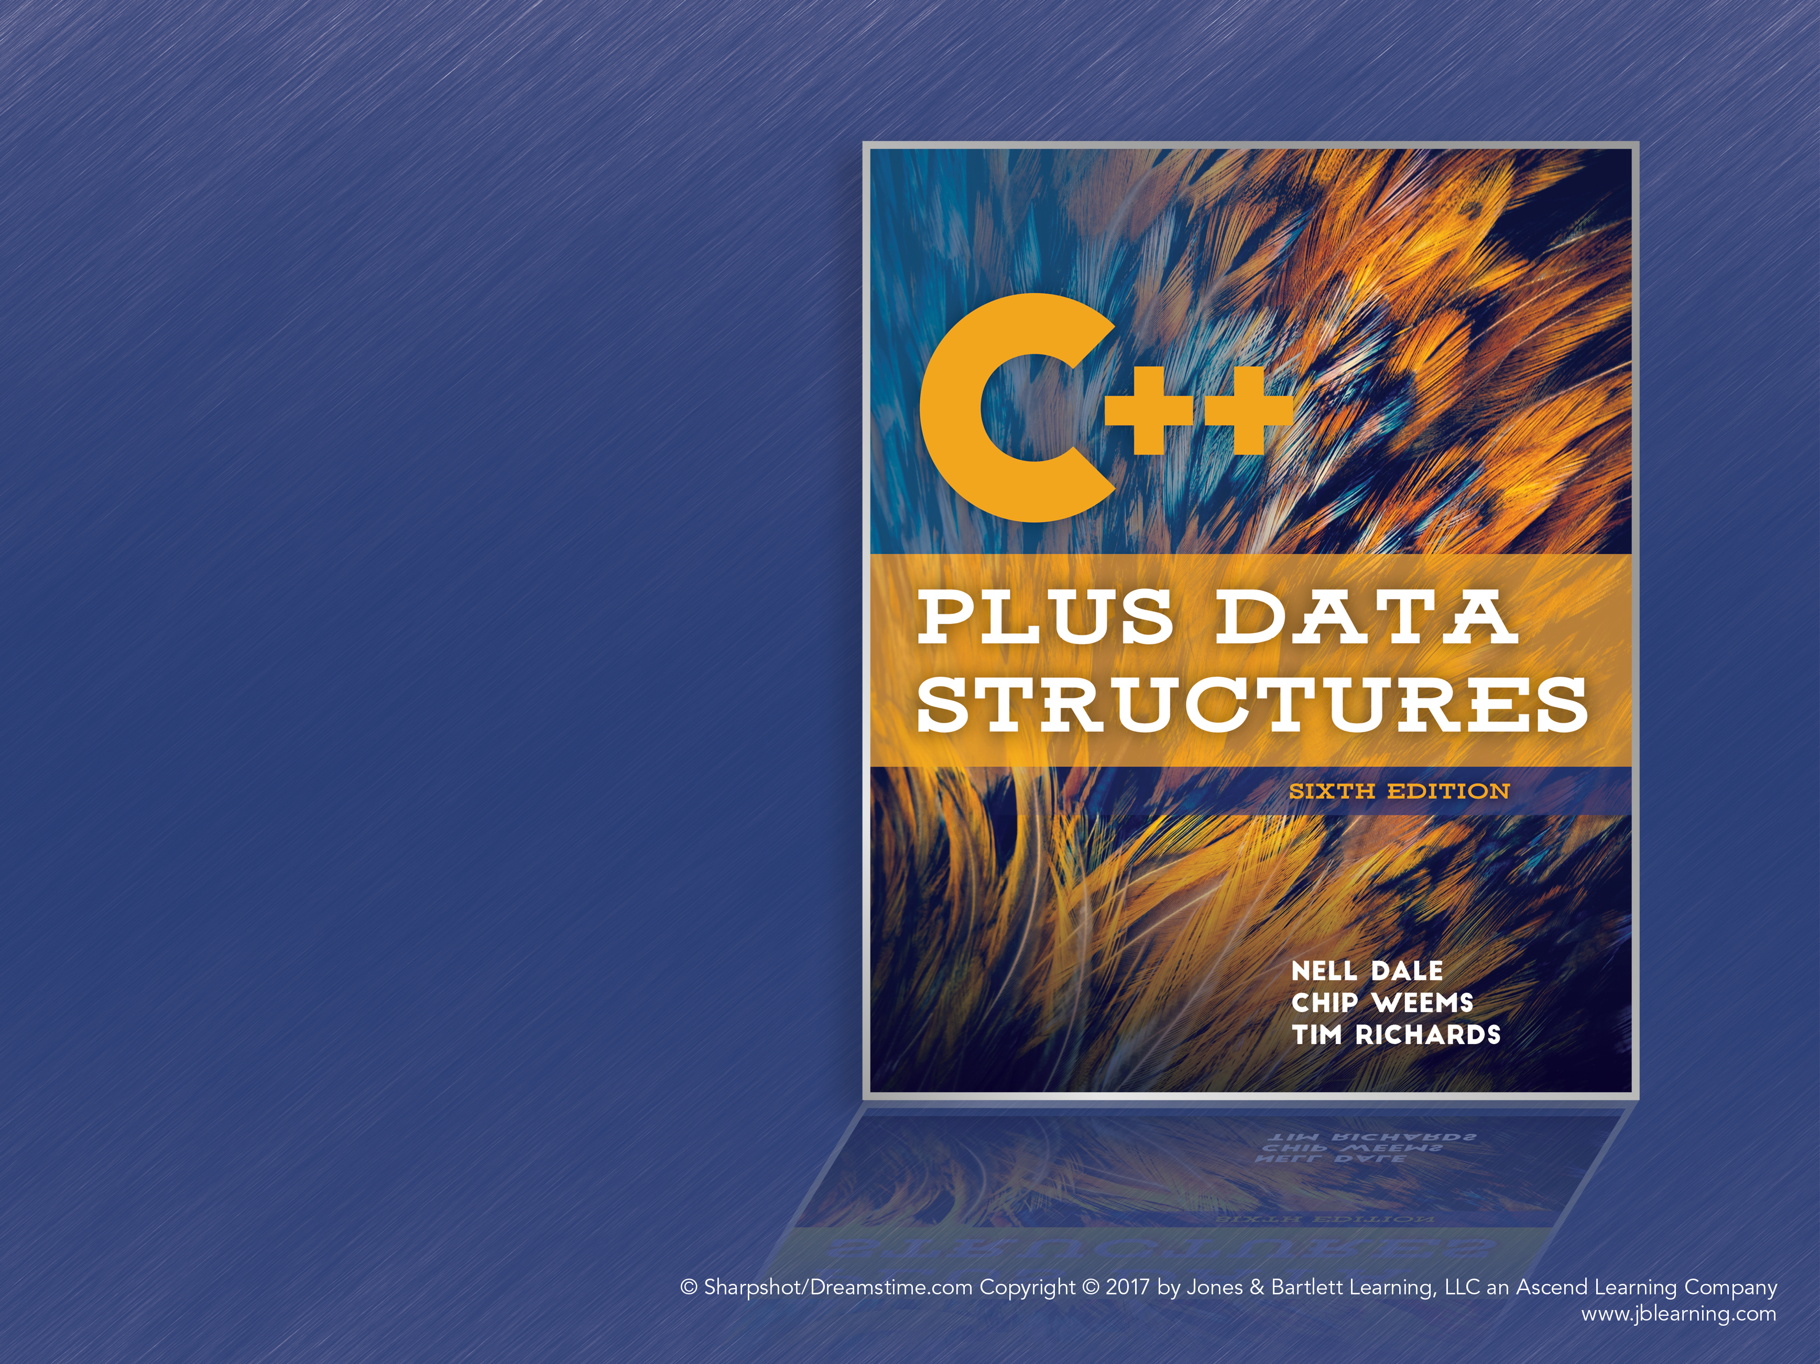
Chapter 4
ADT Sorted List
Notes:
1

Slide 2
Sorted List: Logical Level
Only change from unsorted list is guaranteeing list elements are sorted
Order is determined by ItemType’s CompareTo method
PutItem and DeleteItem pre- and postconditions assert list is sorted and remains sorted

Slide 3
Sorted List: Application Level
Nothing has changed for the user; list interface is exactly the same
GetNextItem will return the next item in key order

Slide 4
Sorted List: Implementation Level
Few changes are needed to implement the sorted list
PutItem, DeleteItem: Ensure list remains sorted
GetItem can be improved
First attempt: Will implement an array-based list

Slide 5
PutItem Implementation
Algorithm is simple:
Find the place where new element should go
Create space for the new element
Insert the element in the space
A linear search is sufficient for finding the position
Create space by moving all subsequent elements down one space

Slide 6
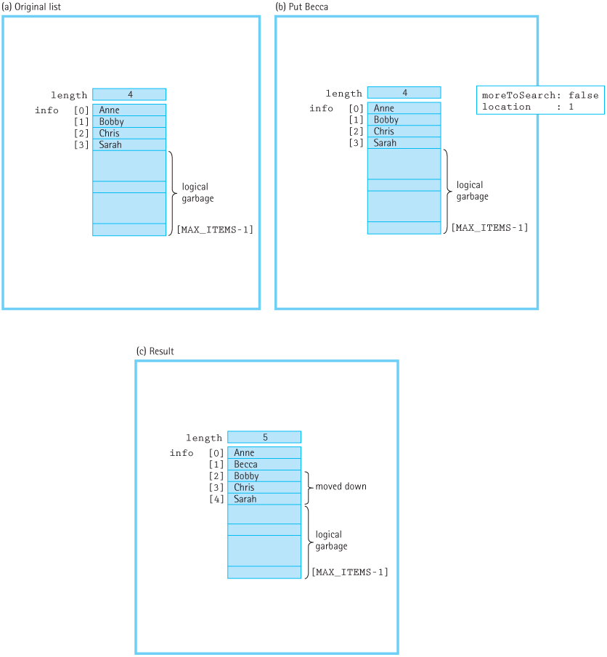
PutItem Implementation (cont.)
Figure 4.1 Putting an item into a sorted list (a) Original list (b) Put Becca (c) Result

Slide 7
DeleteItem Implementation
We assume the item to be deleted is in the list
Again, simple linear search to find the item
Once the item is found
Move every subsequent element up one space (overwriting the element to be deleted)
Decrement length by one

Slide 8
GetItem Implementation
Using a sorted list allows us to improve on Unsorted List’s linear search
Simple optimization: Stop searching the list when we encounter an item greater than what we’re searching for
Example: List is “Alice,” “Bob,” “Diane,” “Ed” and we’re searching for “Chris”
Search can stop once we reach “Diane” because “Chris” must come before “Diane”

Slide 9
GetItem: Binary Search
Binary Search: An O(log₂N) search algorithm where the search area is halved on every iteration
Stops when item is found or when there’s nothing left to search (item is not in list)
Requires a sorted list and random access to list elements (i.e., an array-based list)
Linear search can be faster for smaller N (<20)

Slide 10
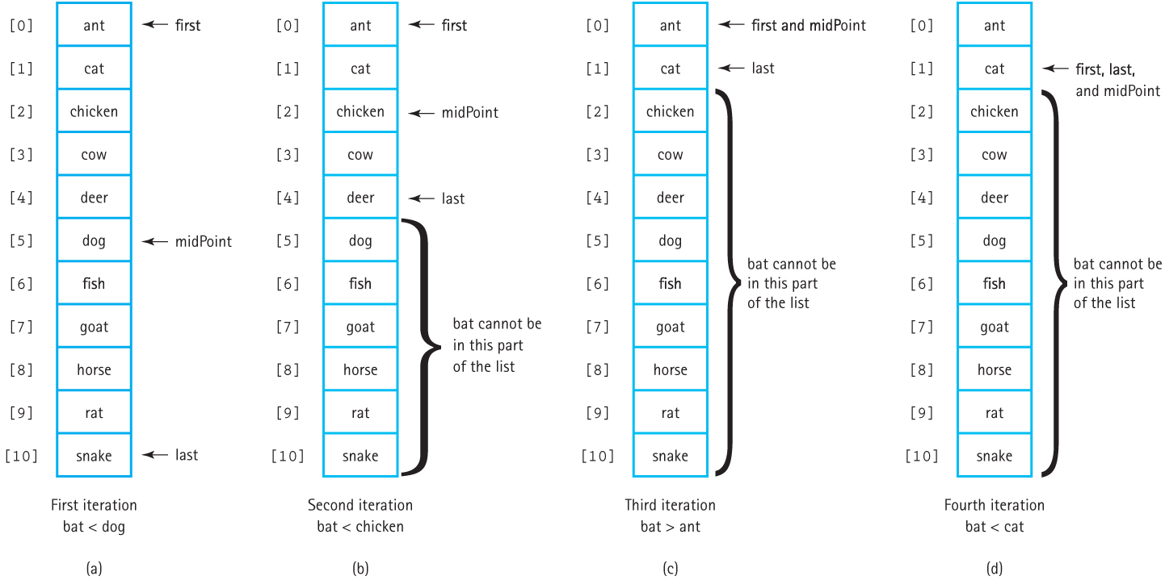
Binary Search Walkthrough
Figure 4.4 Trace of the binary search algorithm (a) First iteration bat < dog (b) Second iteration bat < chicken (c) Third iteration bat > ant (d) Fourth iteration bat < cat)

Slide 11
Dynamically Allocated Arrays
Dynamically allocated arrays allow clients to decide how many elements to store at run time
Use a pointer to an array of ItemType on the heap
Requires very few changes to implement

Slide 12
Dynamically Allocated Arrays (cont.)
Parameterized constructor: Allows user to specify max number of items
Default constructor: Allocated 500 items; used for arrays of lists
Destructor: Cleans up the memory on the heap when the rest of the list is removed
IsFull: We store the max list size instead of using a constant: length == maxList

Slide 13
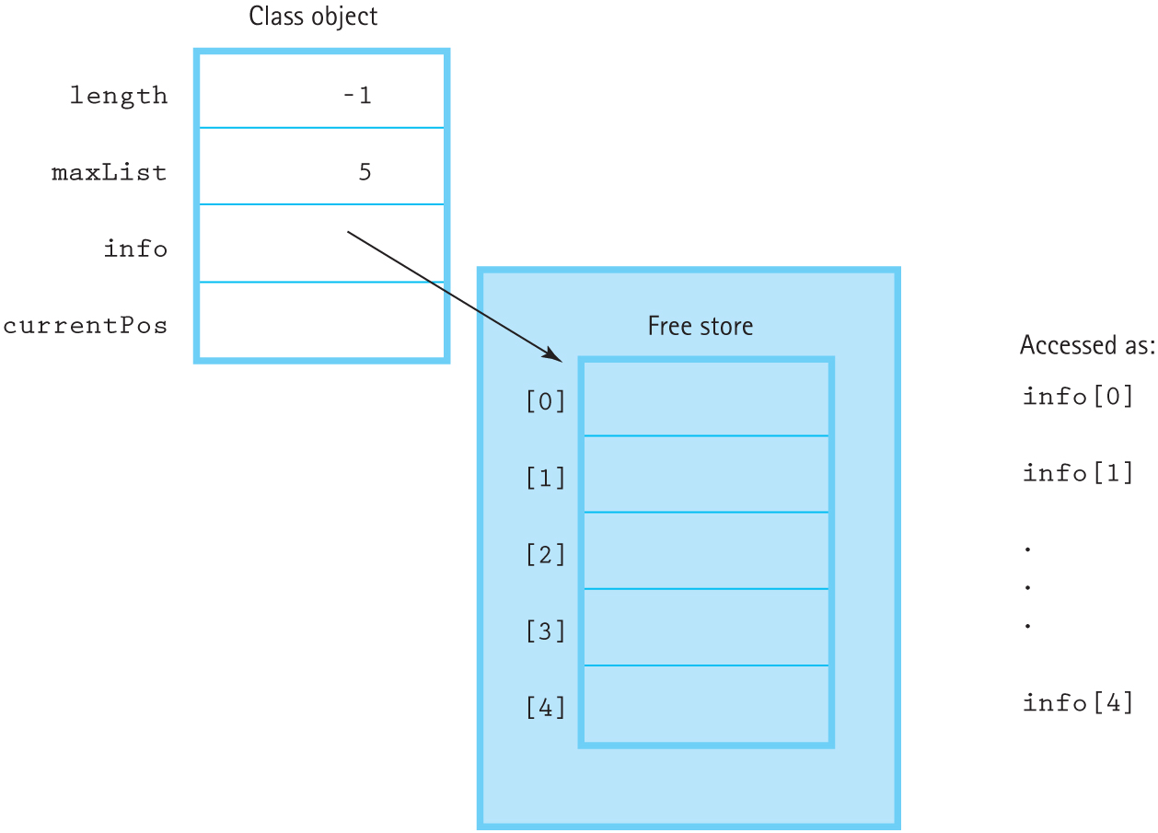
Dynamically Allocated Arrays (cont.)
Figure 4.5 A list in which the array is in dynamic storage

Slide 14
Linked List-Based Sorted List
Very similar to changing array-based Unsorted List to linked list-based
GetItem changes since searching the list is different
PutItem and DeleteItem must handle changing links between nodes

Slide 15
Linked List Implementation: GetItem
The same simple optimization is usable: Stop once we reach an item that comes after the item we’re searching for
If CompareTo returns Equal, item has been found
If CompareTo returns Less, item is not in the list
Cannot use Binary search here. Why?
Binary search requires being able to randomly access elements of the list
Linked lists can only access directly linked nodes

Slide 16
Linked List Implementation: PutItem
The algorithm starts the same: Search through the list to find the location for the new item
Example: List contains “Alex,” “Chris,” “John,” and “Kit,” and we want to insert “Becca”
Search stops at “Chris” because “Becca” < “Chris”
Prepare a new node for “Becca,” which points to “Chris” as the next node
We need “Alex” to point to “Becca,” but since we don’t have a pointer to “Alex,” we can’t modify it!

Slide 17
Linked List Implementation: PutItem (cont.)
Possible solution: Always look ahead one node
That is, compare against (location->next)->info
But this will cause an exception when we reach the end of the list
Solution: Use a second pointer that points to the previous node
Will be NULL if inserting at the beginning of the list, which is a special case

Slide 18
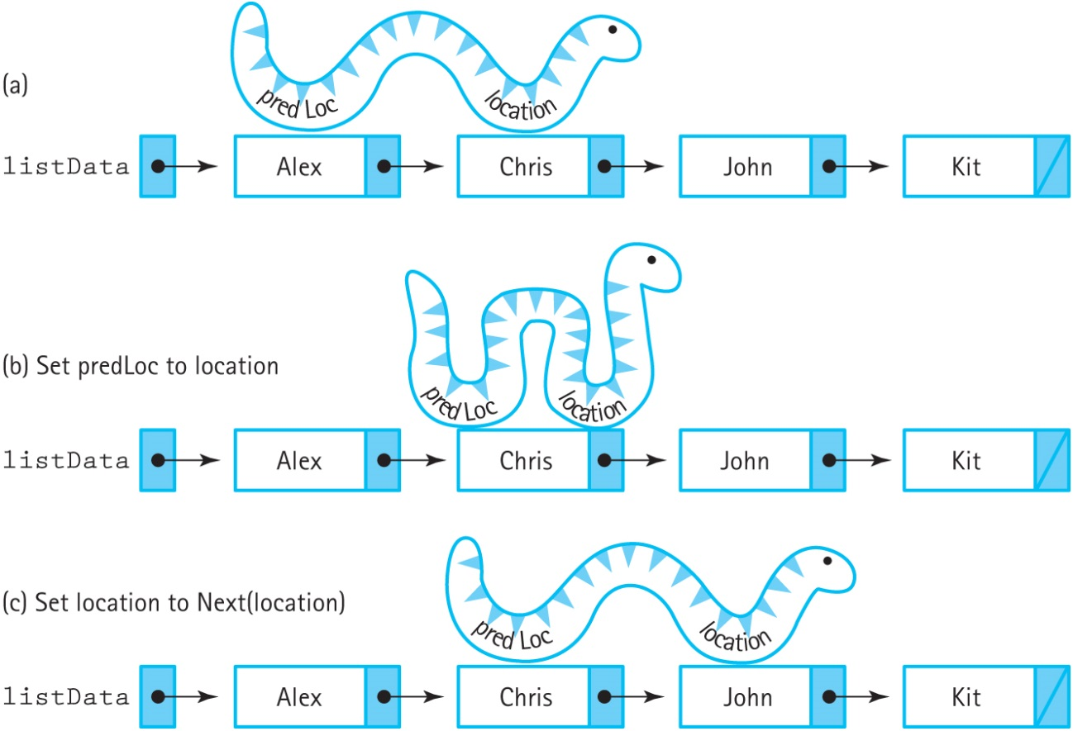
Linked List Implementation: PutItem (cont.)
We update both pointers at the same time, creating an “inchworm effect”
Figure 4.9 The inchworm effect (a) (b) Set predLoc to location (c) Set location to Next(location)

Slide 19
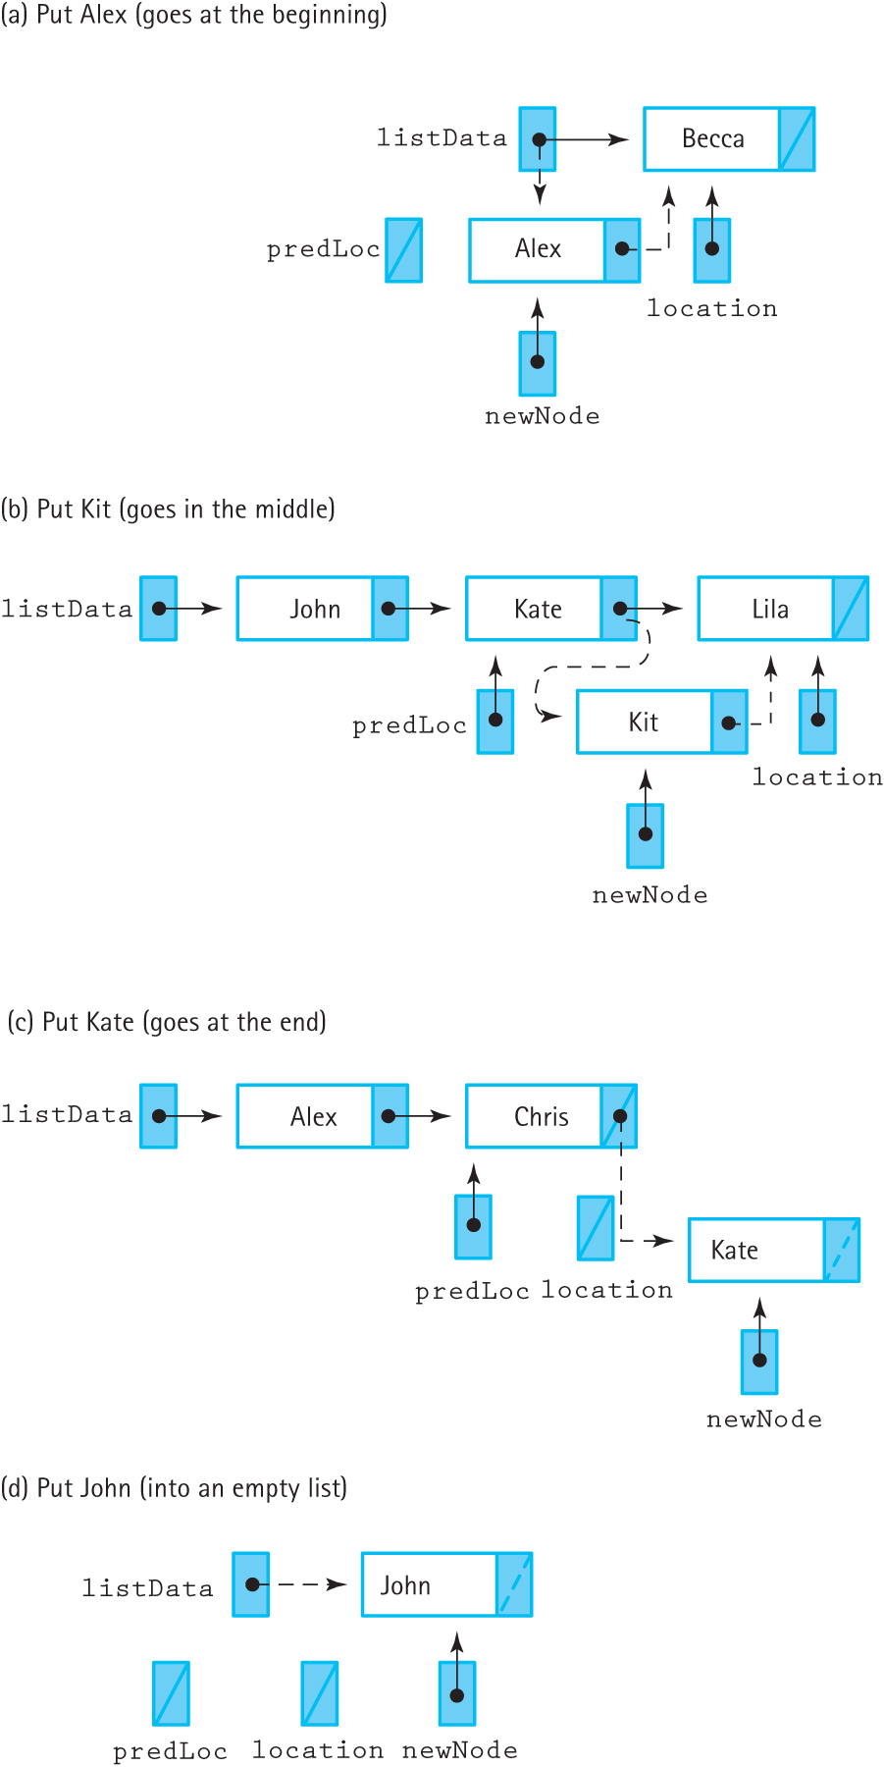
Figure 4.10 Four insertion cases (a) Put Alex (goes at the beginning) (b) Put Kit
(goes in the middle) (c Put Kate (goes at the end) (d) Put John (into an empty list)

Slide 20
Linked List: DeleteItem
DeleteItem doesn’t change much, but it must handle updating pointers
Two options:
Use the same algorithm as the unsorted list: compare against (location->next)->info to find the item to delete
Mirror the PutItem algorithm so it removes the node using two location pointers
As with PutItem, there are four cases to consider

Slide 21
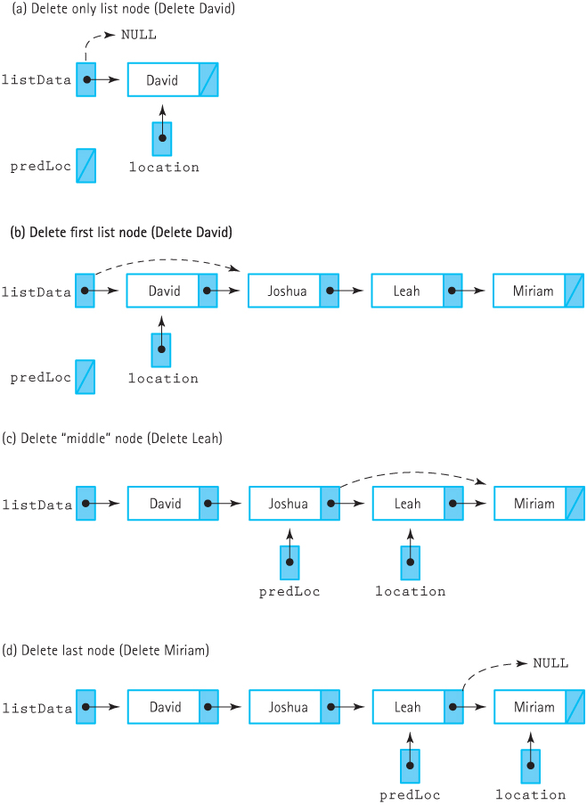
Figure 4.11 Deleting from a linked list: (a) Delete only list node (Delete David)
(b) Delete first list node (Delete Radio) (c) Delete "middle" node (Delete Leah)
(d) Delete last node (Delete Miriam)

Slide 22
Comparing Sorted List Implementations
GetItem: Array-based can use binary search, which is O(log₂N), but linked list-based is stuck with sequential O(N) search
PutItem: Array-based requires searching plus moving all subsequent items, while linked list-based only needs to search; both are O(N), but linked list-based does less work overall
DeleteItem: Same as PutItem; both are O(N) and therefore roughly equivalent

Slide 23
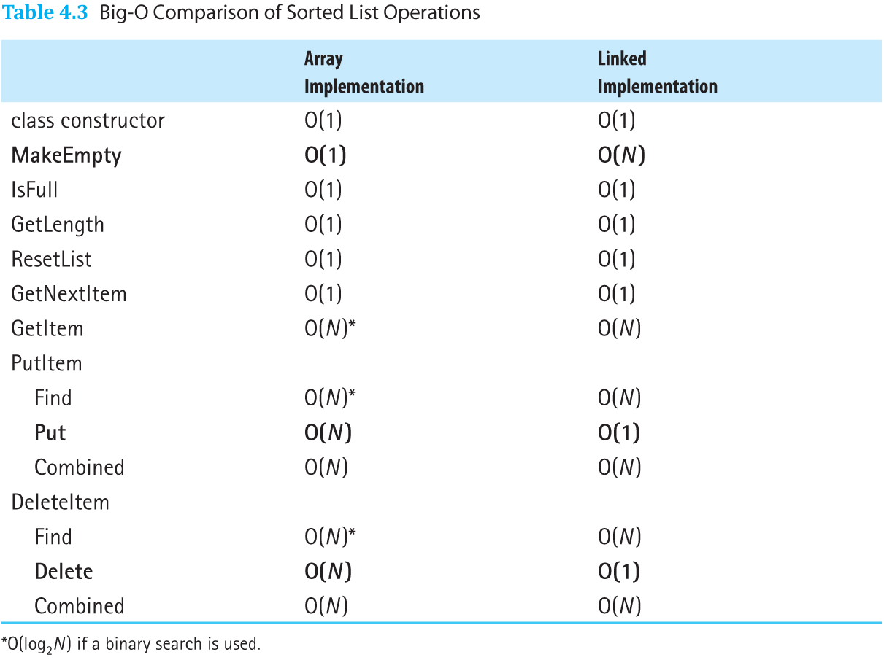
Sorted List Implementations
Table 4.3 Big-O Comparison of Sorted List Operations

Slide 24
Sorted List vs. Unsorted List
The main difference is PutItem
Unsorted List is O(1) because it doesn’t care about order
Sorted List is O(N) because it must search the list to find where the item should go
GetItem in a Sorted List can be more efficient than an Unsorted List if binary search is used

Slide 25
Bounded and Unbounded ADTs
Bounded ADT: There is a logical limit on the number of items in the structure
Unbounded ADT: There is no logical limit on the number of items in the structure
Are our lists bounded or unbounded?

Slide 26
Bounded or Unbounded Lists
The array-based list is bounded and the linked list-based list is unbounded, but this is an implementation difference
The dynamically allocated array-based list uses arrays but can be unbounded by allocating more memory as needed
Clients only know an ADT is bounded or unbounded if the documentation tells them so

Slide 27
Object-Oriented Design Methodology
Four main steps to object-oriented design:
Brainstorming
Filtering
Scenarios
Responsibility Algorithms

Slide 28
Brainstorming
A group problem-solving technique where all members of the group spontaneously contribute ideas
All ideas are potentially good ideas
Think fast and furiously, and ponder later
Give every voice a turn
A little humor can be a powerful force
The goal is to produce a list of candidate classes for solving the problem at hand

Slide 29
Filtering
Take the list of classes from the Brainstorming step and determine which classes are core to solving the problem
You may find some classes are duplicates, or others could be combined into a single class
Once complete, CRC cards should be written for the remaining classes

Slide 30
Scenarios
Scenario: A sequence of steps that describes an interaction between a client and a program
A set of related scenarios is a use case
Goal of this step is to assign responsibilities to each class
Responsibility: A task handled by a class; something a class should know or be able to do
Scenarios help us decide the tasks in a program and which classes handle each task

Slide 31
Responsibility Algorithms
This step involves writing the algorithms for each responsibility
Knowledge responsibilities usually just return data encapsulated by the class
The top-down design approach is usually sufficient for implementing action responsibilities

